Slide 1
IBM University Engagement Project Submission
“Exploring the Power of Agentic AI with IBM Granite and LangFlow”

Slide 2

Project Title – CGM Gujarat Platform: AI-Powered Cotton & Groundnut Market Linkage
Domain of Project – Economic Development / Agriculture
Student Name | Recent Passport Photo | Email ID | Mobile number [WhatsApp]
Meet Tailor |  | meettailor2022@gmail.com | 9265126838

Slide 3
Problem Statement -
Problem Statement : AI-Powered Cotton & Groundnut Market Linkage Platform
The Challenge
Gujarat is a leading producer of cotton and groundnut, yet farmers frequently face price exploitation by middlemen. Farmers lack access to real-time mandi prices, direct market linkages, and have limited bargaining power. Without AI-driven price intelligence and direct connections, farmers are unable to make informed selling and storage decisions.
The Objective
Create Agentic AI solutions that provide real-time price intelligence, connect farmers directly with buyers, and support informed selling and storage decisions.
Mandi Price Forecasting Agent – Predicts 7-day mandi price trends using 30-day historical data to guide SELL NOW / STORE / WAIT decisions.
Direct Buyer-Farmer Matching Agent – Scores and ranks farmer crop listings against buyer requirements for direct, middleman-free connections.
Storage & Selling Timing Advisor Agent – Calculates net gain for 1–4 week storage scenarios and recommends optimal selling timing.
Quality Grading Assistance Agent – Grades crop quality (Grade A/B/C) using AI analysis of uploaded photos and farmer-provided notes.
Farmer Income Dashboard Agent – Summarizes earnings, inventory, and provides actionable financial insights for farmers.

Slide 4
Proposed Solution -
Proposed Solution: CGM Gujarat Platform
The proposed solution is a full-stack multi-agent AI platform built using IBM Bob (LangFlow), IBM Granite LLM, and IBM Cloud to eliminate middlemen exploitation and connect Gujarat cotton & groundnut farmers directly with buyers through AI-powered market intelligence.
The platform consists of three portals: a Farmer Portal (crop listings, mandi price charts, AI forecasts, buyer offers, income dashboard), a Buyer Portal (purchase requirements, AI-matched farmer listings, offer management), and an Admin Portal (user management, mandi price data, AI agent activity logs).
The system comprises five IBM Granite-powered AI agents:
Mandi Price Forecasting Agent analyzes 30-day price history and predicts 7-day trends with SELL NOW / STORE / WAIT recommendations.
Buyer-Farmer Matching Agent scores and ranks farmer crop listings against buyer requirements enabling direct, middleman-free trade.
Storage & Selling Advisor Agent calculates net gain for 1–4 week storage scenarios to advise optimal selling timing.
Quality Grading Agent grades cotton/groundnut quality as Grade A/B/C from crop photos and farmer notes.
The Income Dashboard Agent summarizes farmer earnings and inventory with AI insights. The React + Vite frontend (built with TailwindCSS) provides bilingual (English + Gujarati) UI.
IBM Bob (LangFlow) orchestrates all agent workflows. The Node.js + Express backend with SQLite and JWT authentication provides secure, scalable APIs for all three portals.
Overall, this platform delivers an end-to-end intelligent market linkage system that eliminates information asymmetry and gives Gujarat farmers real bargaining power.

Slide 5
Technology Used
IBM Bob (LangFlow) – Visual multi-agent workflow designer used to orchestrate all 5 AI agents in the CGM platform
IBM Granite LLM – Model used: ibm-granite-3-2-8b-instruct – Powers price forecasting, buyer-farmer matching, quality grading, storage advice, and income insights
IBM Cloud – Provides infrastructure to deploy and scale the CGM platform. Enables a reliable, secure, and scalable environment for the Node.js backend, React frontend, and all AI agent services.
Node.js + Express + SQLite – Backend API with JWT authentication, serving Farmer, Buyer, and Admin portals with secure, role-based data access
React + Vite + TailwindCSS – Bilingual (English + Gujarati) frontend with live mandi price charts, AI forecast panels, and farmer income dashboards
GitHub – Public repository: https://github.com/MeetTailor-Data/cgm-gujarat-platform

Slide 6
IBM Bob (LangFlow) component Used -
1) Chat Input – Entry point where farmers and buyers submit queries, crop data, or price lookup requests.
2) IBM watsonx.ai AI Agent – Routes requests to the appropriate specialized agent (forecasting, matching, grading, storage, or income) using IBM Granite LLM.
3) IBM Granite Model Used – ibm-granite-3-2-8b-instruct → Powers all 5 agents for reasoning, price prediction, quality grading, and market matching
4) Chat Output –Returns AI-generated responses: mandi price forecasts, matched buyer lists, quality grades, storage recommendations, or income summaries.
5) API / Tool Component – Calls backend Node.js REST APIs to fetch real-time mandi prices, crop listings, buyer requirements, and transaction data from SQLite database.
6) Conditional Router Component – Directs agent flow based on user role (Farmer / Buyer / Admin) and query type to the correct specialized AI agent pipeline.

Slide 7
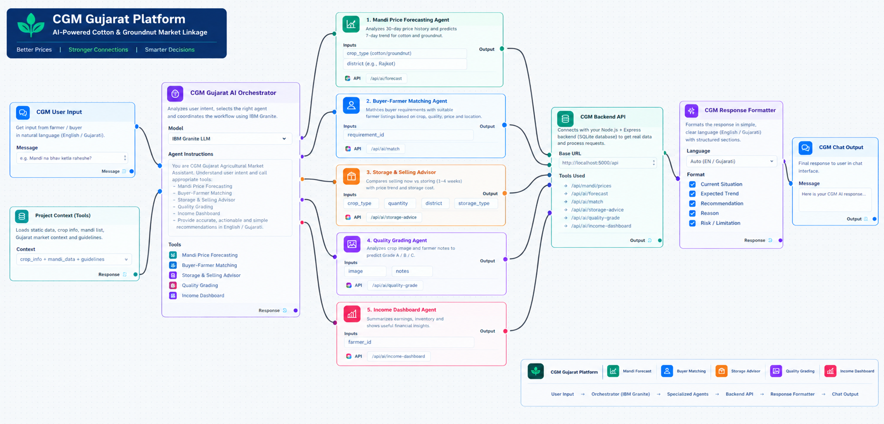
Langflow workflow -

Slide 8
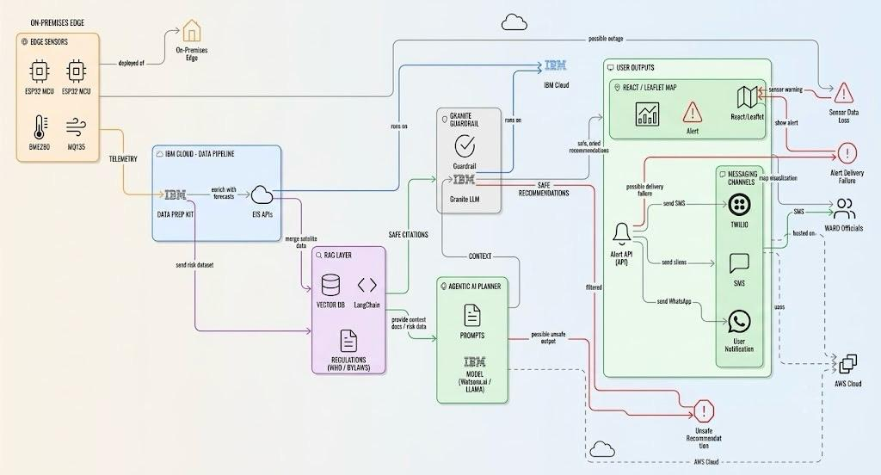
Architecture blueprint

Slide 9

Role of Agentic AI in the solution
Role of Agentic AI in CGM Gujarat Platform
Agentic AI enables the CGM Gujarat Platform to function as an intelligent, autonomous market intelligence system rather than a static price-lookup tool. Using IBM Bob (LangFlow) and IBM Granite LLM, it coordinates five specialized agents to deliver real-time market intelligence and direct farmer-buyer connections.
Each agent performs a specific role—such as forecasting mandi prices, matching buyers with farmers, grading crop quality, advising on storage, and generating income insights—while working collaboratively. This multi-agent approach ensures efficient task routing and accurate, context-aware market recommendations.
Agentic AI also brings context awareness, understanding farmer details like crop type, quantity, quality grade, and location to generate tailored market recommendations. It supports real-time adaptation, continuously updating forecasts and recommendations based on live mandi price data and buyer activity.
Additionally, agents communicate with each other—for example, the quality grading result feeds into the matching agent to improve buyer-farmer compatibility scores.
Overall, Agentic AI makes the platform proactive, personalized, and goal-driven, acting like a smart digital market advisor that empowers Gujarat farmers to negotiate better prices and access direct buyers.

Slide 10
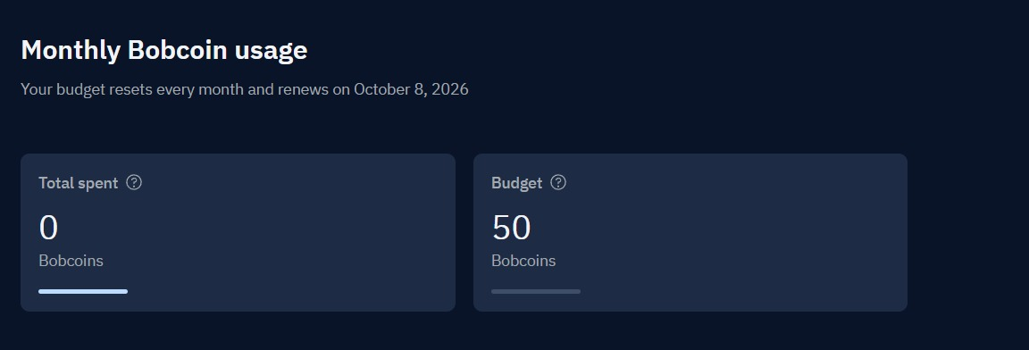
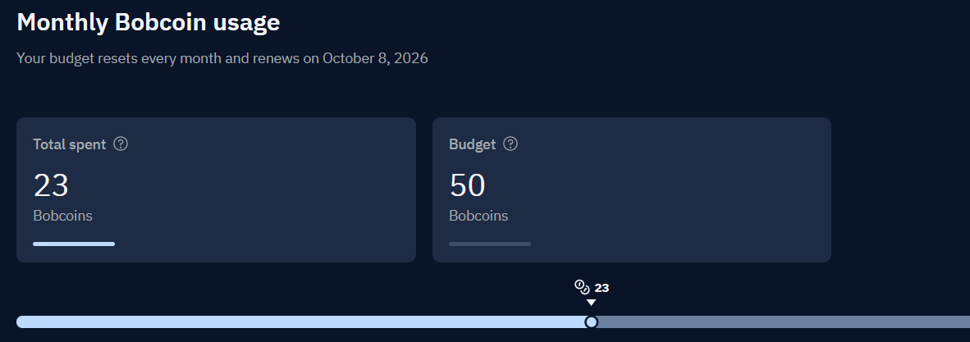
Token Usage
23 token are used
Before Prompt
After the Prompt
·
·
·

Slide 11
Novelty and Uniqueness
The CGM Gujarat Platform stands out by combining Agentic AI, real-time market data, and bilingual accessibility into a single intelligent market linkage system.
Multi-Agent Intelligence – Five specialized IBM Granite agents collaborate: price forecasting, buyer-farmer matching, quality grading, storage advice, and income dashboard.
Direct Market Linkage – Eliminates middlemen by directly connecting farmers with buyers through AI-scored compatibility matching.
Bilingual & Inclusive – Full English + Gujarati (ગુજરાતી) UI ensures accessibility for rural farmers with limited English literacy.
Real-Time Price Intelligence – Live mandi price charts with 30-day history and 7-day AI forecasts give farmers market foresight.
AI Quality Grading – Farmers upload crop photos for instant AI-powered Grade A/B/C quality assessment before listing.
Fallback Mock Mode – All AI agents automatically fall back to deterministic mock mode when IBM credentials are not configured, ensuring reliable hackathon demos.
Full-Stack & Deployable – Complete Node.js backend + React frontend deployable on IBM Cloud with JWT auth, SQLite, and all IBM Granite agents production-ready.
This makes the platform a smart, adaptive, and proactive digital market intelligence system, not just a static price-lookup board.

Slide 12
Git Hub Link
GitHub Repository (Public):
https://github.com/MeetTailor-Data/cgm-gujarat-platform
Repository contains:
app.json, problem statement PDF, project PPTX, full Node.js backend, React + Vite + TailwindCSS frontend, 5 IBM Granite AI agent files, and README with setup + IBM Cloud deployment guide.
·
·
·

Slide 13
Future Scope
1. SMS & WhatsApp Alerts for Price Drops –
Integrate SMS and WhatsApp notifications so that farmers receive instant alerts when mandi prices cross a target threshold. This ensures farmers without smartphones or internet access still benefit from AI-driven price intelligence.
2.Voice Assistant in Gujarati –
Add a Gujarati-language voice assistant powered by IBM Granite so that farmers can query mandi prices, list crops, and receive recommendations entirely through voice. This dramatically improves accessibility for rural farmers with low digital literacy.
·
·
·

Slide 14
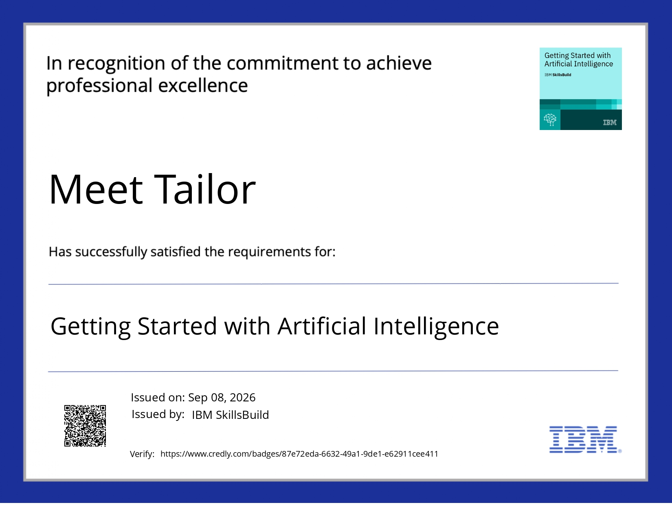
Certificates Earned:

Slide 15
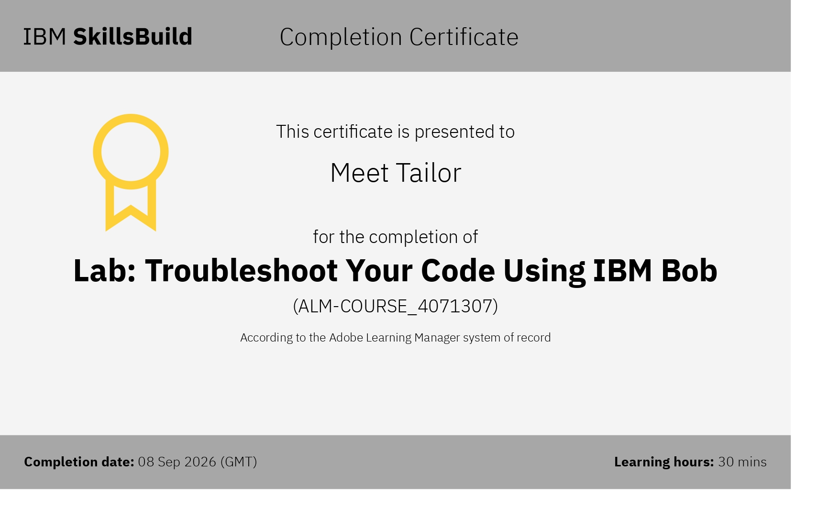
Certificates Earned:​

Slide 16


